Slide 1

Oceanography

Slide 2
Factsheet
The oceans may be defined as the vast body of saline water that occupies the depressions of Earth's surface.
71% of global surface area is ocean, 21% is land.
Water:Land 1.5:1 in Northern Hemisphere & 4:1 in Southern Hemisphere.
Average ocean depth is approximately 4km (average land height is 1,2km)
While only 11% of land surface of earth is more than 2km above sealevel, 84% of sea bottom is more than 2km deep.
The average temperature of the oceans is 3.9ºC. The Pacific Ocean occupies 46% of the world ocean area, Atlantic:23%, Indian Ocean 20%, Rest of the seas occupy 11%.
Notes:
2

Slide 3
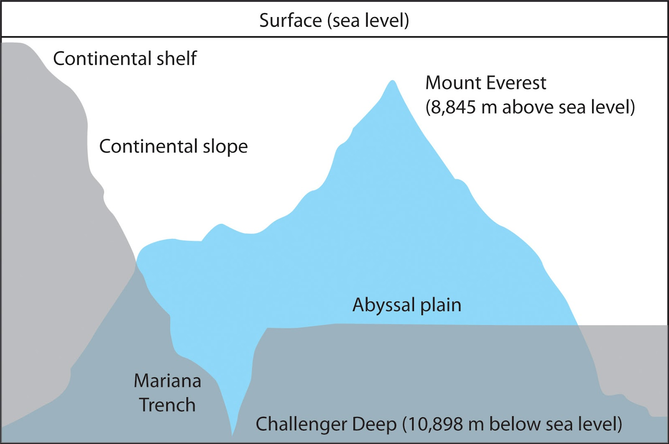
https://sites.psu.edu/nanspassion/2016/02/10/mariana-trench/comment-page-1/

Slide 4
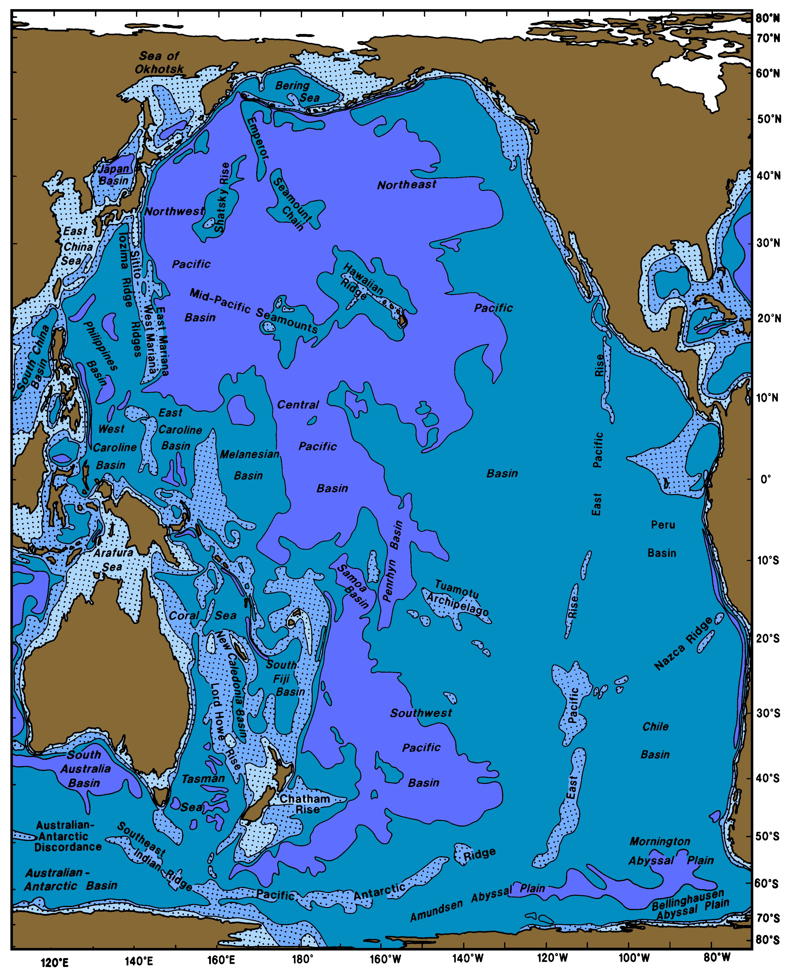
Pacific Ocean has a surface area of 181.34 × 10⁶ km². The Pacific Ocean extends northward from Antarctica to the Bering Strait.
The boundary between the Pacific and Indian Ocean follows the line from the Malay Peninsula through Sumatra, Java, Timor, Australia at Cape Londonderry, and Tasmania.
From Tasmania to Antarctica it is the meridian of South East Cape on Tasmania 147◦E.

Slide 5
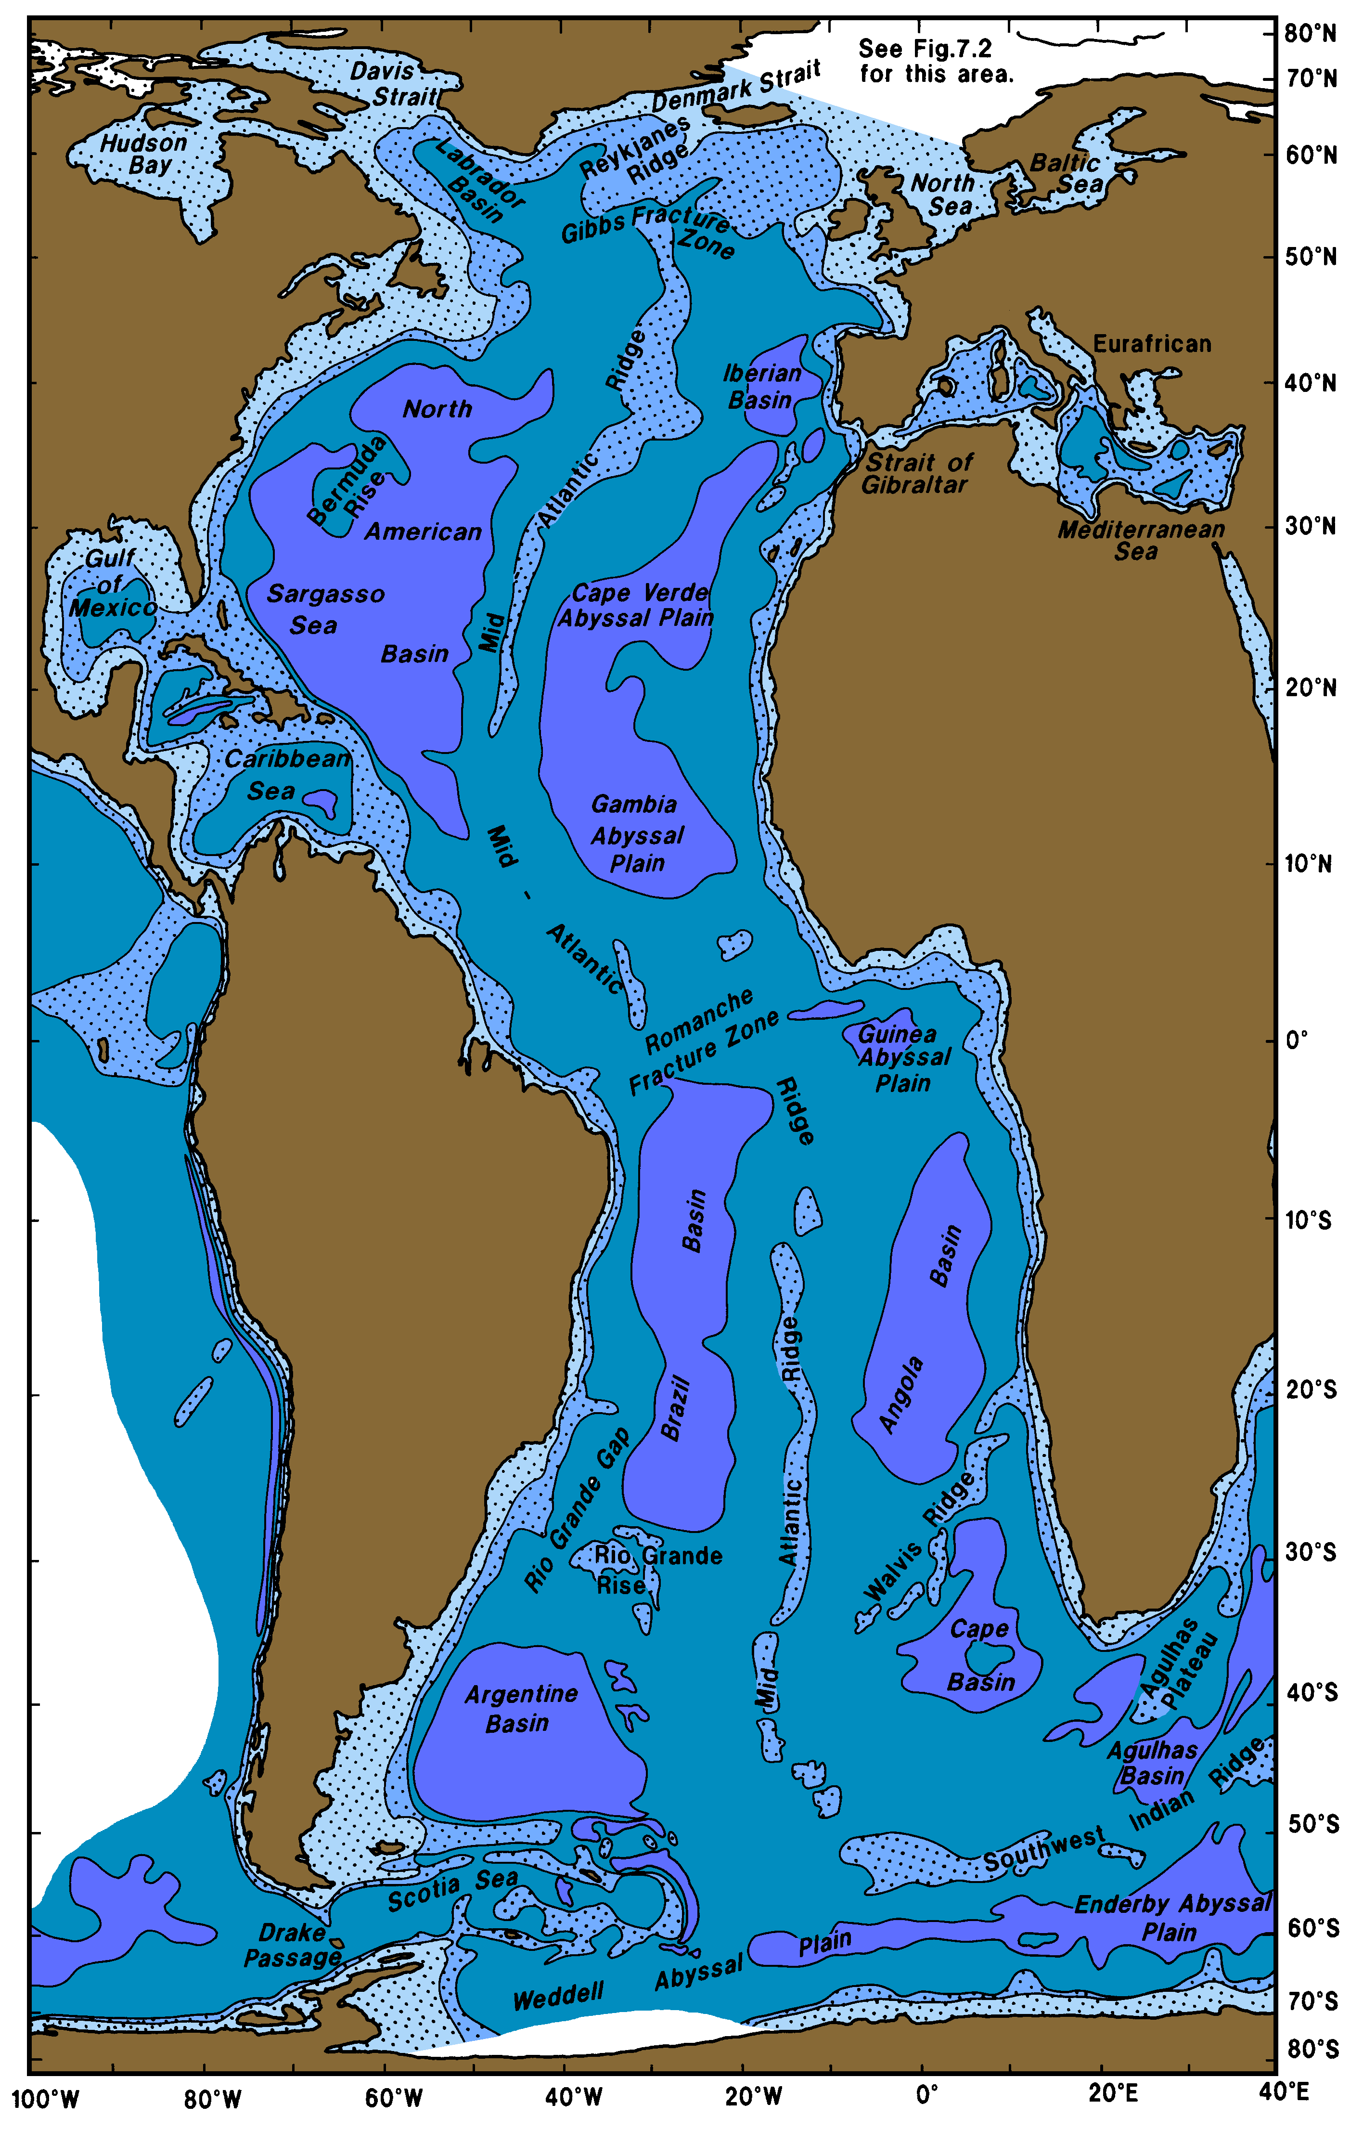
Atlantic Ocean with a surface area of 106.57 × 10⁶ km² is the second largest ocean.
The Atlantic Ocean extends northward from Antarctica and includes all of the Arctic Sea, the European Mediterranean, and the American Mediterranean more commonly known as the Caribbean sea.
The boundary between the Atlantic and Indian Ocean is the meridian of Cape Agulhas (20◦E).
The boundary between the Atlantic and Pacific is the line forming the shortest distance from Cape Horn to the South Shetland Islands.
In the north, the Arctic Sea is part of the Atlantic Ocean, and the Bering Strait is the boundary between the Atlantic and Pacific.

Slide 6
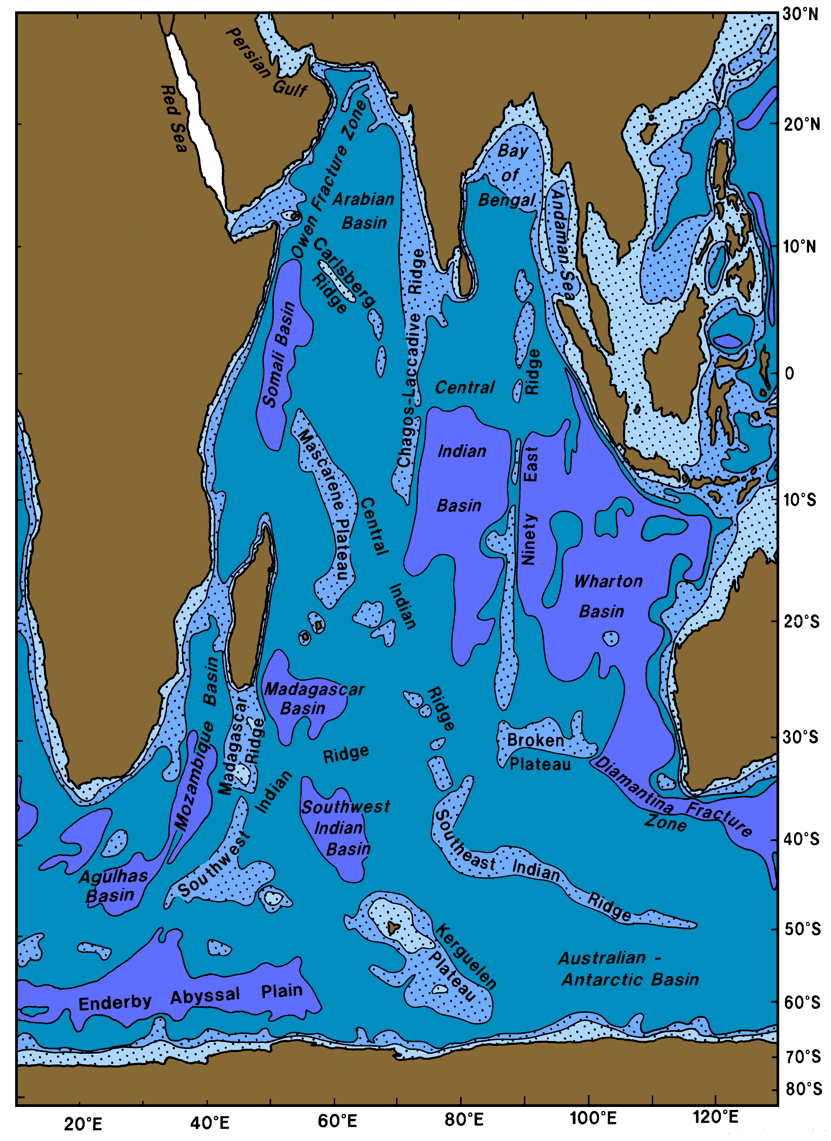
Indian Ocean: 74.12 × 10⁶ km².
The Indian Ocean extends from Antarctica to the continent of Asia including the Red Sea and Persian Gulf.
Some authors use the name Southern Ocean to describe the ocean surrounding Antarctica.

Slide 7
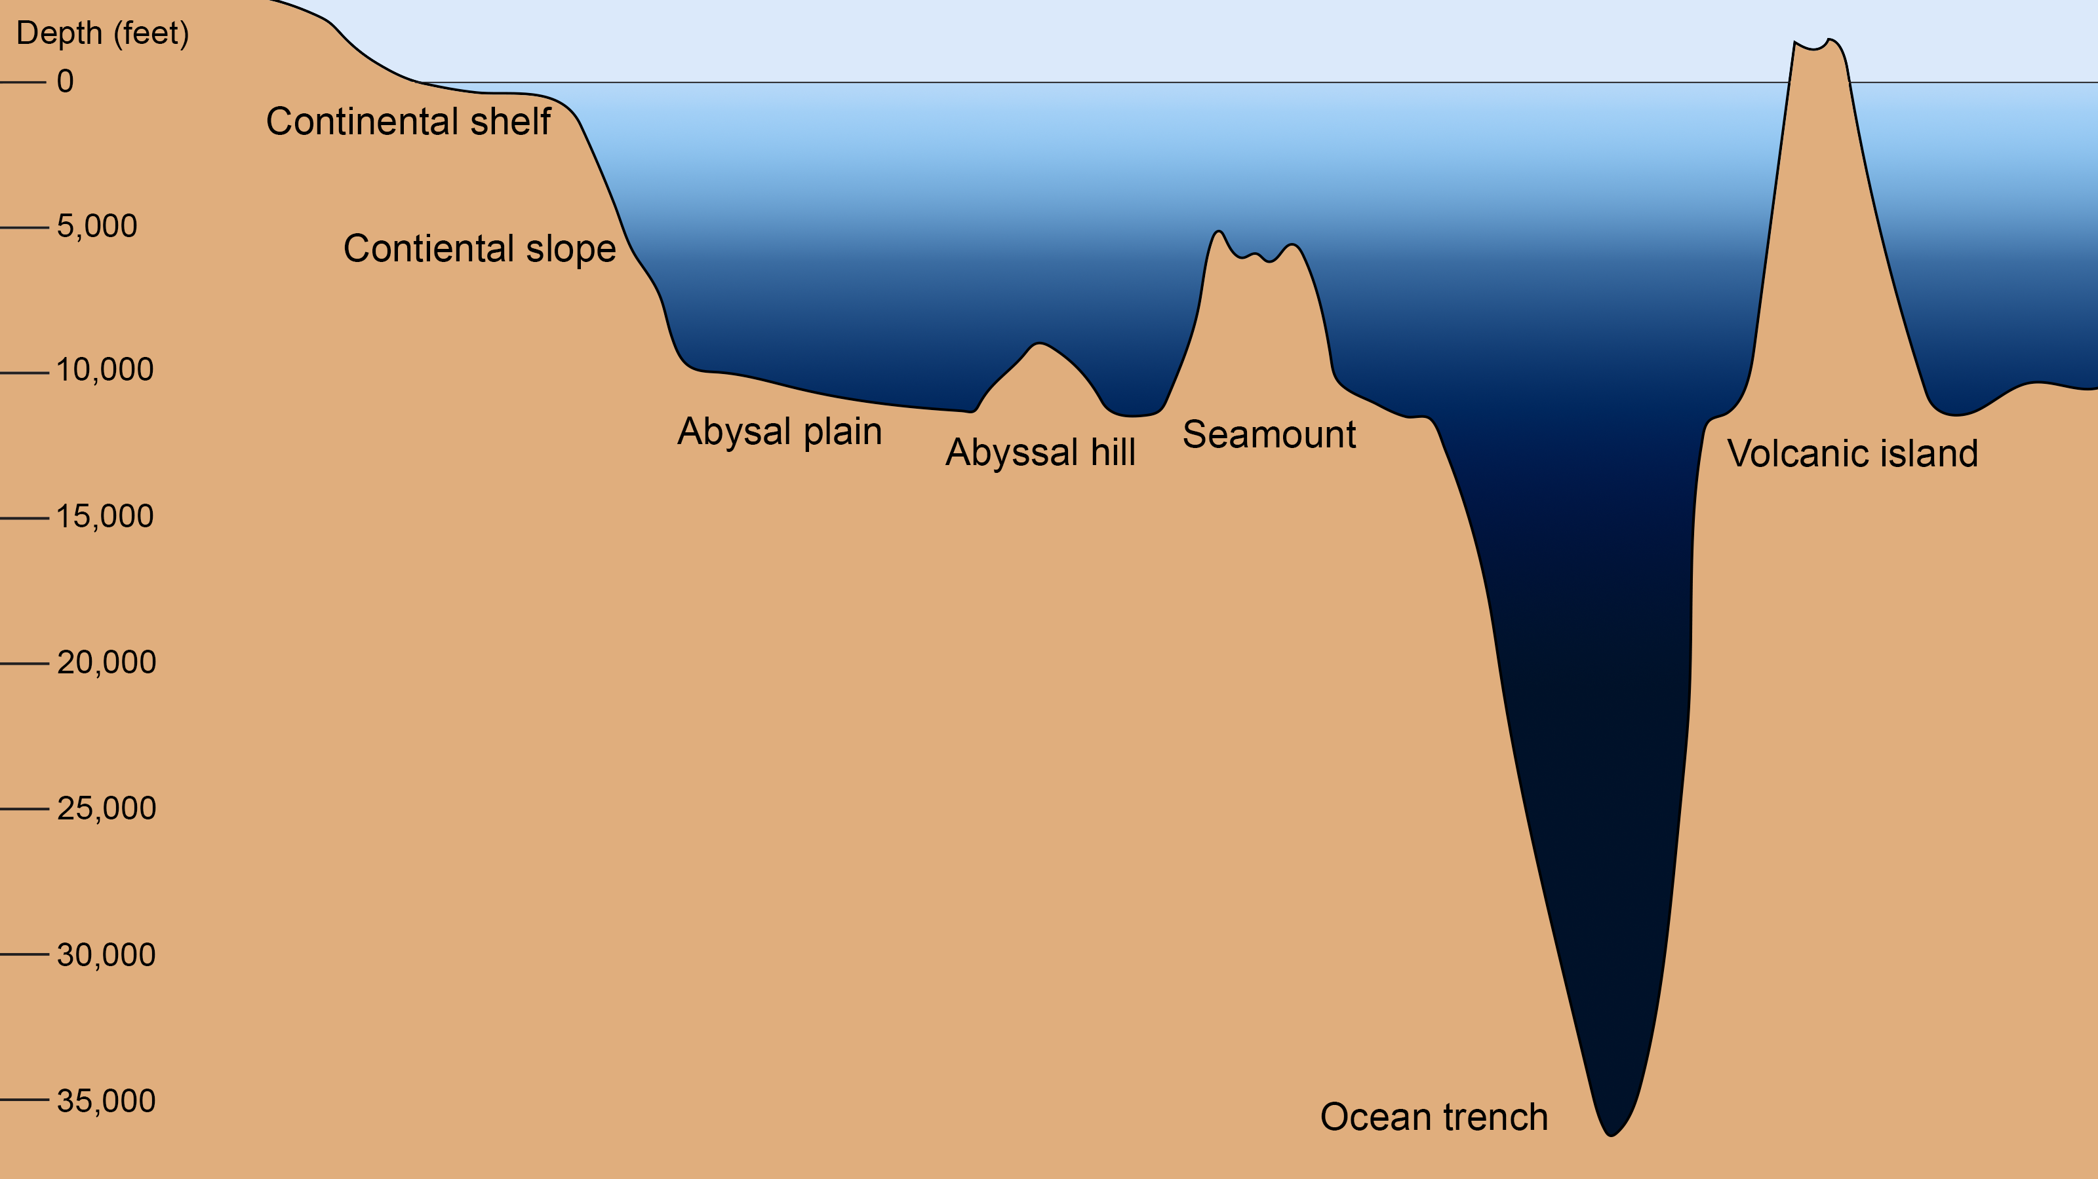
Earth’s rocky surface is divided into two types: oceanic, with a thin dense crust about 10 km thick, and continental, with a thick light crust about 40 km thick.
The deep, lighter continental crust floats higher on the denser mantle than does the oceanic crust, and the mean height of the crust relative to sea level has two distinct values: continents have a mean elevation of 1100 m, the ocean has a mean depth of -3400 m.
The crust is broken into large plates that move relative to each other. New crust is created at the mid-ocean ridges, and old crust is lost at trenches. The relative motion of crust, due to plate tectonics, produces the distinctive features of the sea floor, including mid-ocean ridges, trenches, island arcs, and basins.
https://www.noaa.gov/education/resource-collections/ocean-coasts/ocean-floor-features

Slide 8
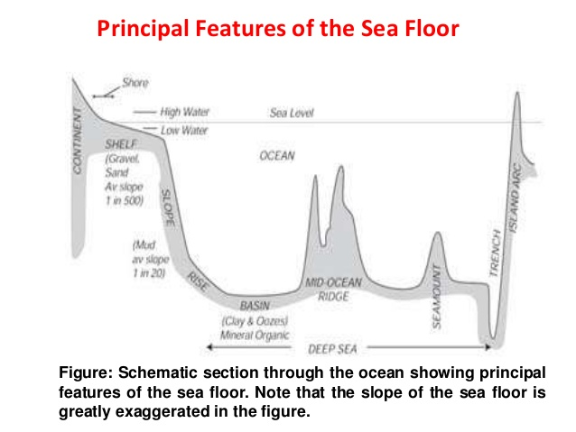
Basins
Canyons
Continental shelves
Continental slopes
Seamounts
Sills
Plains
Trenches
Ridges

Slide 9
Key variables
Temperature
Salinity
Ocean currents
Ocean colour, sea level

